Slide 1

Jason Choi, Isha Bhandari, Ann McClure, Justin Henley, Pooja Masani, Nayana Patil, and Shashank Bandaru
Notes:
Nayana

Slide 2

Objective
Develop a website that allows users to input a word or phrase and receive a list of episodes and seasons where that term appears.
Similar to Shazam but for shows.
Notes:
Nayana

Slide 3
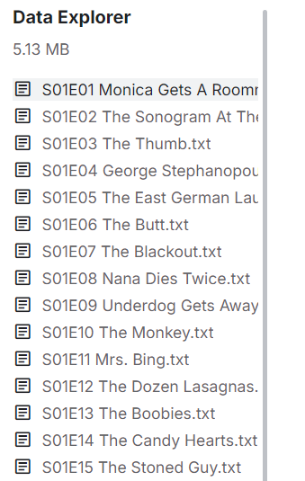
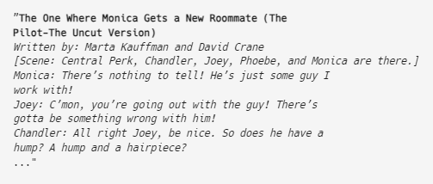
Data Used
Transcripts from the dataset are imported manually into the database (mongodb), with user-defined show name, season number, and episode number
FRIENDS TV Series - Screenplay Script (kaggle.com)
Notes:
Ann

Slide 4
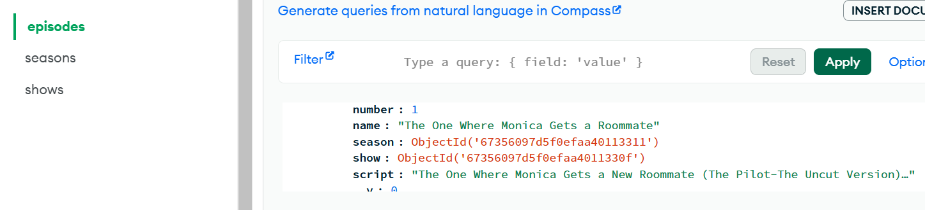
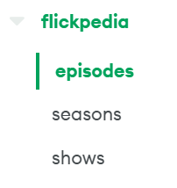
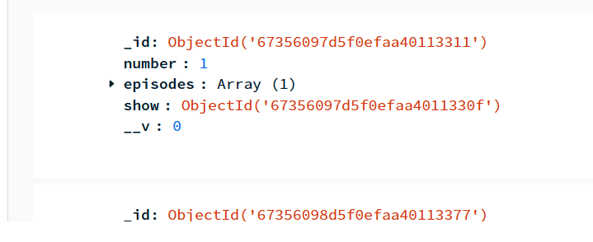

Data within our Database
Notes:
shashank

Slide 5
Models/Algorithms Used
Search Library - Fuse.js
Uses fuzzy search to find approximate matches based on the string provided rather than needing exact matches
Simple to implement with a lot of features
Scores based on three factors
Fuzziness score
Takes into account the location, distance, and threshold to find an approximate match for the search term
Key Weight (Optional)
User provided weight for search term for a higher relevance score
Field-Length Norm
If a pattern matches a shorter field like a ‘Title’, then that will produce a higher relevance score than a longer field like ‘Script’
Notes:
jason

Slide 6

Results
Based off of the words in the quote entered by the user the tool will return possible episodes with similar quotes/words
Notes:
Isha

Slide 7
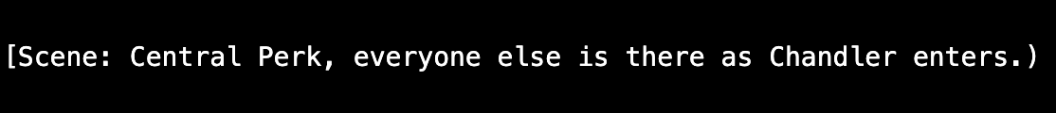
Primary Issues
Transcripts include scene information and commercial breaks
We only want to show results of actual quotes from the show
Transcripts we pulled from Kaggle occasionally had improper formatting which could throw off the results
Ex: Scene information usually was found in between [ ], but occasionally the end bracket ] was left off, or was a ), etc
When searching, special characters such as [, *, $, etc could cause issues
Only works for exact matches
Ex: “Hello” would pull up results but “Hello_” or “Hell0” would not
Notes:
justin

Slide 8

Future Work
We would like to expand this website to multiple different shows
Implement filters for users to narrow search results by show, genre, or release year, enhancing search usability.
Incorporate a machine learning algorithm that generates various potential matches rather than restricting the output to an exact match with the provided quote.
Notes:
pooja

